Slide 1

Project - Phase 1
India Crime Insight
Team Members (Name with Roll.No.):
Arpit Nayak(22BDS006)
Ajay Rajput(22BDS049)
Viraj Surana(22BDS064)
Ganesh Bhabad(22BDS067)
Github Repo Link:

Slide 2
Overview of the Project
Dataset / Feature description: The dataset contains crime statistics for various states and districts in India, with columns such as 'States/UTs', 'District', 'Year', and various crime categories like 'Murder', 'Rape', 'Kidnapping & Abduction', and 'Theft'. Each row represents data for a specific district and year, detailing the number of incidents for different types of crimes. The dataset includes 91 columns, covering a wide range of criminal offenses, allowing for comprehensive analysis of crime patterns and trends across different regions.
Project’s Scope/ Deliverables: Key deliverables include an interactive dashboard with maps highlighting crime hotspots, filters to view specific crime types, and tools for analyzing crime trends over time, providing insights into crime patterns and aiding in decision-making for law enforcement and policy planning.
Tools and Technologies used: Power BI,Kotlin,Android Studio,Python,Google Colab

Slide 3
Progress Achieved (Phase 1)
Highlight key milestones and tasks completed. (Include %of work completed)
So far, the project on developing the Crime Data Visualization App has made significant progress. We have successfully cleaned and pre-processed the dataset, which has set the stage for visualizing crime statistics. Some of the initial graphs are ready, providing valuable insights into crime patterns. Additionally, the login page of the app is complete, marking an essential milestone. Overall, we have accomplished around 30% of the work, with data preparation and UI development well underway.
Discuss challenges faced and solutions implemented.
During the development of the Crime Data Visualization App, we faced challenges with ensuring accurate and timely data integration and designing intuitive visualizations. To address these issues, we implemented robust data validation processes and leveraged advanced visualization libraries to enhance clarity and interactivity.

Slide 4
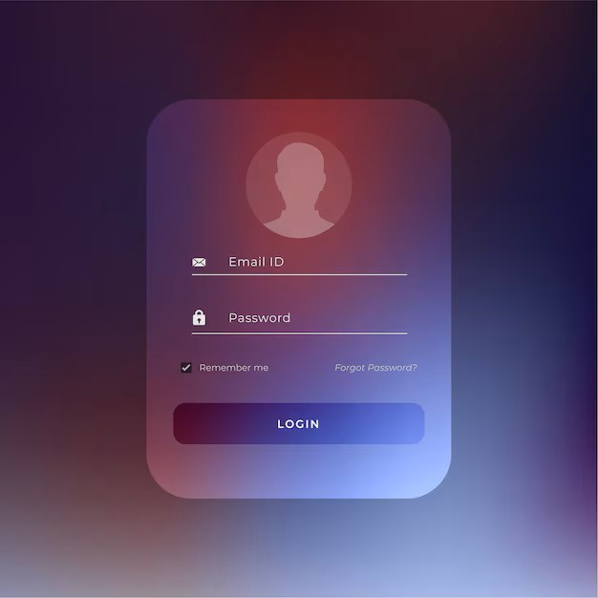
Progress Achieved (Phase 1)
Include screenshots of any results, features, or functionalities achieved so far.
Screenshot of our app’s login page:

Slide 5
Plan for Next Phase
Outline the plan for the next phase of the project.
In the next phase of the project, we will focus on integrating the interactive features into the app. Firstly, we will start by developing the main dashboard where users can interact with crime maps to view hotspots by district and state. Secondly, we will implement crime type filters to allow users to narrow down the data based on specific crime categories. Additionally, we will incorporate trend analysis graphs to showcase crime trends over time. Finally, we will ensure that these components are seamlessly integrated and provide a smooth user experience, and we will test these features thoroughly to identify and fix any issues before moving on to the final design and deployment stages.
Mention the timeline and milestones to be achieved
1) Week 1: Setup and Initial Development
Milestone 1:- Data Integration and Backend Setup:
Integrating the cleaned and preprocessed dataset into the app.
Setting up the backend infrastructure (e.g., database connections, API endpoints) to handle data queries and updates.
Milestone 2: Interactive Maps Implementation
Developing and integrating interactive maps to display crime hotspots.
Ensuring that the maps are interactive and responsive, with features such as zooming and panning.

Slide 6
2) Week 2: Feature Development and Design
Milestone 3: Crime Type Filters
Implementing filter options for different types of crime.
Allowing users to select and view specific crime categories on the maps and graphs.
Milestone 4: Trend Analysis Graphs
Creating graphs to show crime trends over time.
Ensuring that graphs are interactive and updated based on user-selected filters or map regions.
3) Week 3:User Interface and Experience Enhancement
Milestone 5: UI/UX Design Improvement
Enhancing the user interface for better usability and aesthetics.
Ensuring that interactive elements are intuitive and the app is user-friendly.
Milestone 6: Integration of Login Functionality
Finalizing and test the login page.
Ensuring secure authentication and session management.

Slide 7
4) Week 4:Testing and Optimization
Milestone 7: Comprehensive Testing
Performing thorough testing of all features, including maps, filters, and trend analysis.
Fixing any bugs or issues identified during testing.
Milestone 8: Performance Optimization
Optimizing app performance, including loading times and responsiveness.
Conducting performance tests to ensure the app handles large datasets efficiently.
5) Week 5:Finalization and Deployment
Milestone 9: Final Review and Refinements
Conducting a final review of the app and make any necessary refinements based on feedback.
Milestone 10: Deployment and Documentation
Deploying the app to the production environment.
Preparing and providing documentation for the app, including user guides and technical details..

Slide 8
Conclusion / References
A brief summary of the project’s progress and its significance.
Our project’s progress includes creating the app's login page and generating 2 to 3 insightful graphs. This app is significant as it empowers users to visualize and understand crime patterns, aiding in better decision-making for law enforcement and community safety initiatives. The graphs helps us to visualize the data of the dataset better, and also provide insights for future visualization.
List any resources, tools, or references used during this phase.
Power BI
Android Studio
Google Colab

Slide 9
Thank You !!!

